Slide 1

Digital Forensics Module
Open Source Forensic Tools Demonstration
Presented by:
Leroi June Yen Hao (S10223468J)
Lor Jing Xiang Eugene (S10223426J)

Slide 2
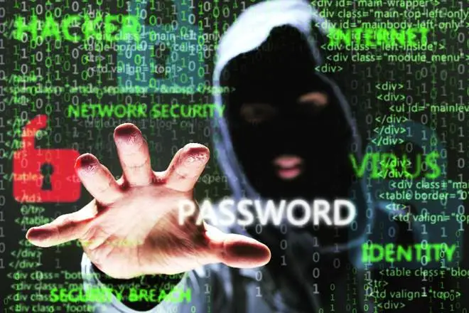
CASE DESCRIPTION
An Individual in a company was found doing unauthorized actions
Bank transfers were made on the persons PC to an unrecognized bank account
The police was alerted regarding the unauthorized action by the user
After interview, the individual claims to not have done anything
Police seized the individual laptop along with an external hard disk

Slide 3


SEIZED EVIDENCE
Laptop running on Windows 10 OS
32GB Sandisk USB Stick

Slide 4



TOOLS
The evidence will be processed and analyzed using the following tools in this order:
MagicRescue: Recover any deleted data and files that may be useful from the USB Stick
Volatility: Command-Line Based Memory Forensics Tool
FTKImager: Create forensic image and memory dump of the laptop

Slide 5
Magic Rescue – Overview
Open-source command line interface tool
Program to be used to recover deleted files
Features:
Recover deleted file that is yet to be overwritten
File Recovery from corrupted partition or drive
Search drive for file using file type
Notes:
Magic Rescue is an Open-source command line interface tool that can be used to recover deleted files
Magic Rescue scans a block device for file types it knows how to recover and calls an external program to extract them. It looks at file patterns in file contents, so it can be used both as an undelete utility and for recovering a corrupted drive or partition.
Its main features are recovering deleted data that has yet to be overwritten, file recovery from a corrupted partition or drive, and can be used to retrieve a file type from a drive

Slide 6
Magic Rescue - Usage
Magic Rescue command:
Magicrescue [options] [device]
Options:
[-b] sets the blocksize
[-d] sets the output directory
[-r] specifies the file type
[M] sets the output mode

Slide 7
Magic Rescue - Recipes (File types)
avi (Audio Video Interleave)
canon-cr2 (Canon Image File)
Elf (Executable and Linkable Format)
Flac (Audio Coding
Flv (Flash video)
gpl
mbox (Email file format)
mbox-mozilla-inbox
mbox-mozilla-sent
mp3-id3v1, mp3-id3v2 (mp3 File)
Msoffice (Microsoft Office File)
nikon-raw (Nikon Image File)
perl
png, jpeg-exif, jpeg-jfif (Image file format)
ppm (Portable Pixmap Format)
Rar (Winrar format)
sqllite
zip & gzip (Compressed file)
Notes:
These are the many recipes that magic rescue can be used to search for.
How it works is that Magic Rescue searches the drive for certain bytes that indicate the start and end of a particular file type and retrieves the file. The numerous recipes contain the respective bytes that indicates the file type.
The above highlighted file types are the ones we will be focusing on today. Msoffice is sort for Microsoft office file which includes word, powerpoint, excel and all the other document types from the Microsoft Office family

Slide 8
FTKImager – Overview
Data preview and imaging tool
Allows user to access overall value of electronic evidence
Create perfect copies or forensic images of computer data
Generate hash reports to prove integrity of case evidence
Notes:
FTK Imager is a data preview and imaging tool that lets you quickly assess electronic evidence to determine if further analysis with other forensic tools. It can create forensic images of local hard drives, CDs and DVDs, thumb drives or other USB devices, entire folders, or individual files from various places within the media.
FTK Imager can create perfect copies, or forensic images of computer data without making changes to the original evidence. The forensic image is identical in every way to the original, including file slack and unallocated space or drive free space. This allows you to store the original media away, safe from harm while the investigation proceeds using the image.
It can also be used Generate hash reports for regular files and disk images to use as a benchmark to prove the integrity of the case evidence.

Slide 9
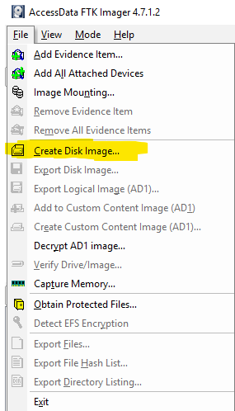
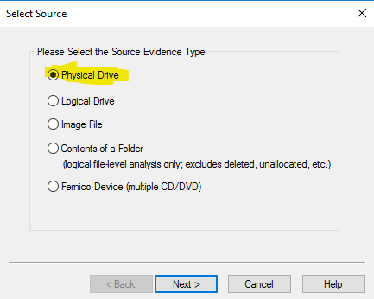
FTK Imager – Imaging
Create disk image of a physical drive
Notes:
Now I will go how to create a disk image of a physical drive using FTK Imager

Slide 10
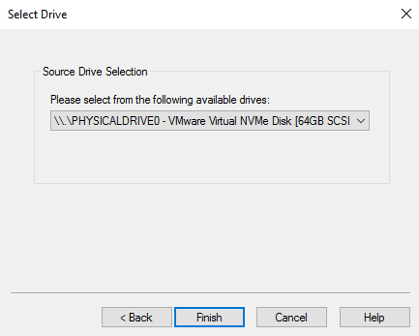
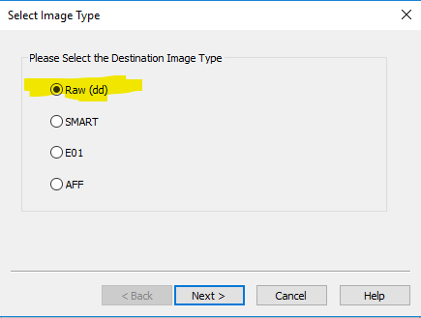
FTK Imager – Imaging
Image output type will be .dd for compatibility
Notes:
Image output type if a raw evidence file so that the image can be used with the widest variety of forensic tools.

Slide 11
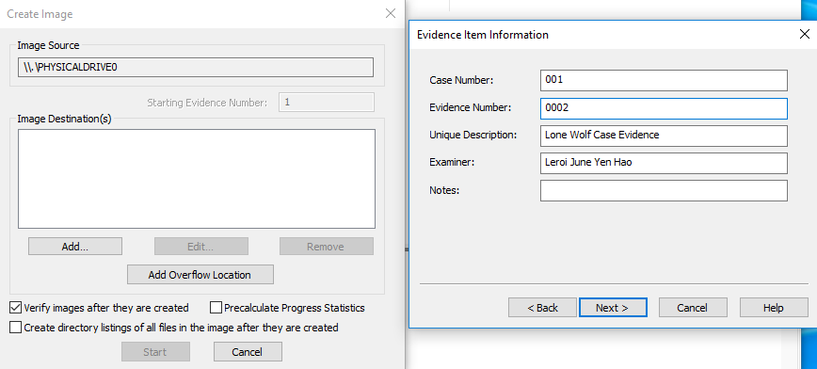
FTK Imager – Imaging

Slide 12
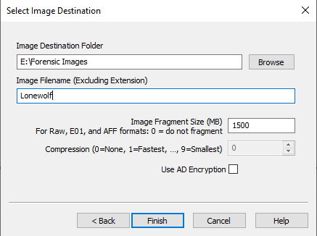
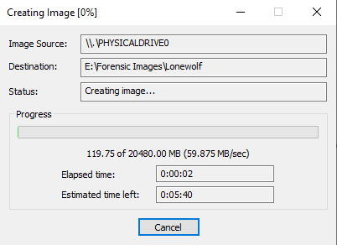
FTK Imager – Imaging

Slide 13
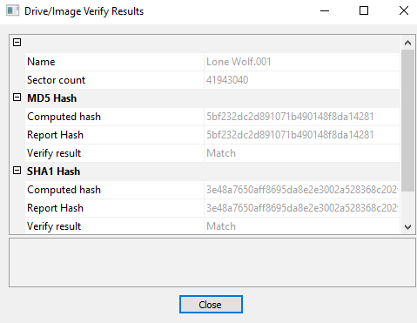
FTK Imager – Imaging

Slide 14
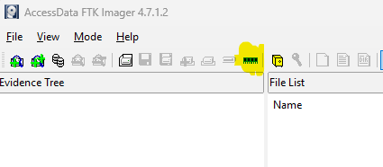
FTK Imager – Memory Dumping
Memory of the evidence at current state and the corresponding pagefile.sys file can be dumped

Slide 15
Volatility – Overview
Open-Source Command Line Interface tool used for Memory Forensics
Offers a Different Source of Information compared to Disk Forensics
Extract Information Such as:
-Running Processes
-Network Connections
-Loaded DLLs
-Operating System
-Hash Dump

Slide 16


Volatility – Configuration
Clones the Git repository to our desktop
Installs the Snappy decompression library
Installs the dependencies required for Volatility

Slide 17
Volatility – windows.info
Used to Extract Information about the Memory Image
Often the First Step in Memory Forensics
Helps Determine the details about Operating System

Slide 18
Volatility – pslist
windows.pslist Provides an Overview of Process in a Memory File
Allows us to Analysis Running Processes
Look Out For ImageFileName, Process and Parent Process ID and Handles

Slide 19
Volatility – windows.handles
Windows.handles Provides a List of Process Open Handle
Handle Value, Type and Name can be Found
Should Filter By Process ID to reduce Noise
Filter by Process ID 3040
Look Out For GrantedAccess and Name

Slide 20
Volatility – windows.dlllist
Windows.handles Provides a List Imported Dynamic Link Libraries (DLLs)
Should Filter By Process ID to reduce Noise
Filter by Process ID 3040

Slide 21
Volatility – windows.netscan
Windows.netscan Provides Network Connections Stored in Memory
Extracted Information Include Local Port Numbers and the Associated Process
Useful for Malware Analysis
Look Out for PID and Owner

Slide 22
Volatility – windows.hashdump
windows.hashdump Extracts and Dump Password Hashes Stored in Memory
Can be used for Password Cracking, Auditing and Verification

Slide 23
Volatility – windows.registry.userassist
windows.pslist Provides Information About User Activity
Gives Information Such as Application and Programs Ran

Slide 24
INVESTIGATION PROCESS: Preliminary Assessment of the Case
Know What To Look For at the Crime Scene
Make A List for Steps to be Taken During Investigation
Establish the Documentation of Evidence (Photographs or Sketches)

Slide 25
INVESTIGATION PROCESS: Preliminary Assessment of the Case
Evidence found:
Evidence 001: 32GB USB Stick
Evidence 002: Laptop running on Windows 10
Steps to be taken during investigation:
Maximise evidence that can be extracted from USB drive
Create a forensics image and memory dump of the laptop
Analyse memory dump

Slide 26
INVESTIGATION PROCESS
FTK Imager will be used to image the suspect’s laptop and obtain the volatile memory dump
Magic Rescue will be used to analyse and gather as much data as it can from the USB Drive
Volatility will be used to analyse the memory dump
Evidence acquisition
Evidence analysis

Slide 27
Investigation Process
Evidence Acquisition using FTK Imager
Evidence Analysis Using Volatility and Magic Rescue
Best Practices should take place such as:
Wearing Gloves when Handling Evidence
Document State of Evidence during Acquisition
Maintain Proper Chain of Custody
Be as Objective as Possible when doing Analysis

Slide 28
INVESTIGATION PROCESS: Preparation Stage
Details of What to Be Seized (Laptops, External Memory)
Tools Required For Acquisition (Write-blockers, Forensics Software)
Tools Required For Documentation (Digital Camera, Notepads, Pens)
Tools Required For Disassembly (Toolkits, Anti-Static Wrist Straps)
Things Required For Packaging of Evidence (Anti-Static bags, Cable Ties, Sturdy Boxes)
Other Miscellaneous Tools (Latex Gloves, Magnifying Glass)

Slide 29
INVESTIGATION PROCESS: Search and Seizure
Voluntary Surrender
When the Primary Owner is Different From the Suspect
Special Arrangement is Needed to Avoid Disruption to Business Function
2. Search Warrant
Allows Law Enforcment Officers to Acquire Evidence from a Suspect's Machine Without Prior Notice

Slide 30
INVESTIGATION PROCESS: First Response Procedures at Crime Scene
Securing the Scene
Ensures That There a No Disturbance during Evidence Collection Process
Done by Security Team, a Search Team will carry out Evidence Acquisition
2. Conducting Preliminary Interviews
Gather Information Such as Owners of Device and Password to Access System
3. Documentation of Scene
Document State of Evidence Such as Mouse Position and Location of Acquisition

Slide 31
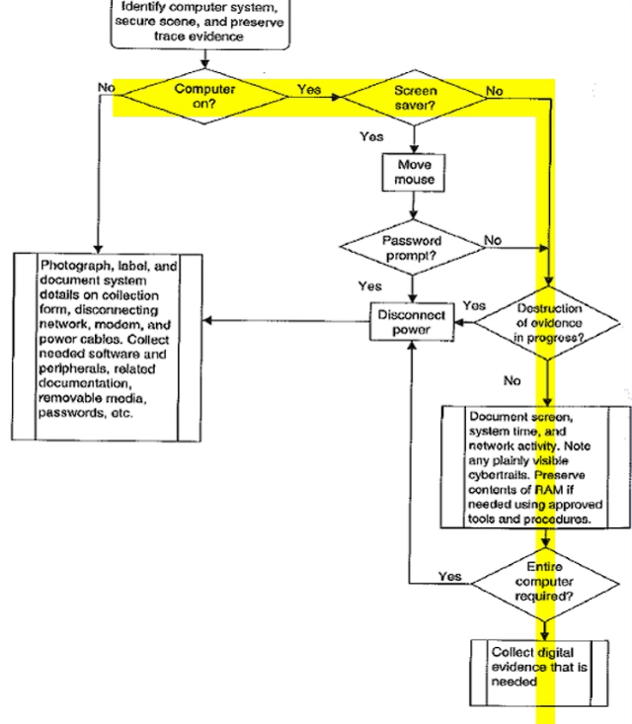
INVESTIGATION PROCESS: First Response Procedures at Crime Scene
4. Searching and Seizing
Use Latex Gloves when Handling Computer Evidence and Avoid Leaving Fingerprints and hairs
Do Not Change the State of Electronic Devices or Equipment (If it's ON, Leave it ON etc.)

Slide 32
INVESTIGATION PROCESS: Chains of Custody
Evidence Presented in Court of Law must Exist in Pristine Condition
The Documentation of Every Move and Access of Evidence is called Chain of Custody
Courts Expect Chain of Custody to be Complete and Without Gaps
The Chain Of Custody starts when Evidence is Collected
It should Answer: Who Collected the Data, Where is It Stored, Who Took Possession of the Evidence, How was the Evidence Stored and Protected During Storage, Who Took Evidence Out of Storage and Why?

Slide 33
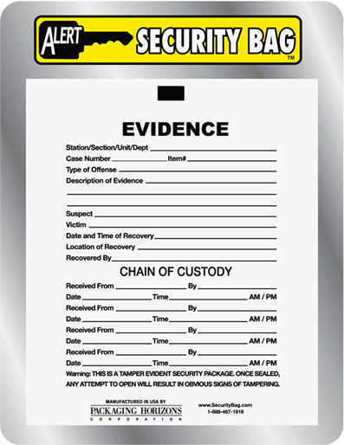
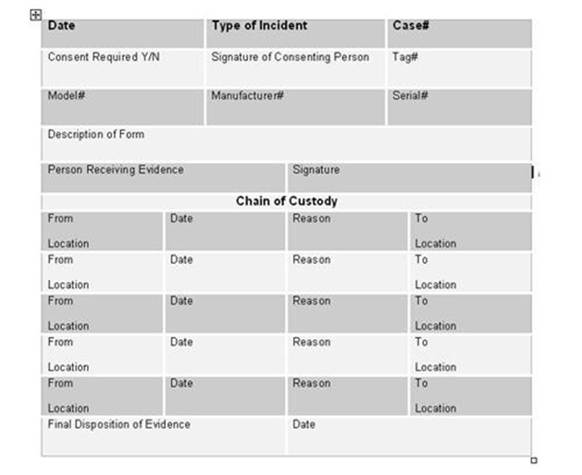
INVESTIGATION PROCESS: Chains of Custody

Slide 34
INVESTIGATION PROCESS: Bagging and Tagging
Bagging
Protects Against Contamination and Tampering
2. Tagging
Provides A Means of Associating the Bagged Evidence with a Particular Location, Date, Time, Case, Event and Seizure agent
The first Link of the Chian of Custody

Slide 35
INVESTIGATION PROCESS: Bagging and Tagging
Exhibit Numbers Should Follow the Format:
aaa/ddmmyy/nnnn/zz where:
aaa is the initials of forensics analyst seizing the equipment
ddmmyy is the date of seizure
nnnn is the sequence number of exhibits seized by aaa starting at 001
zz is the sequence number for the parts of the same exhibit

Slide 36
INVESTIGATION PROCESS: Transporting Electronic Evidence
Keep Electronic Evidence Away from Magnetic Sources to Avoid Damage (Use a Faraday Bag)
Keep Away from High Temperature and Humidity
Do not Place Evidence in Car Boot, Rear Seat is a Better Alternative

Slide 37
INVESTIGATION PROCESS: Maintaining Professional Conducts
Consider All the Available Facts that Account to the Crime Scene
Ignore External Biases to Maintain the Integrity of the Fact-Finding in All Investigation
Keep the case Confidential
Stay Current with the Latest Technical Changes in Computer Hardware and Software, Networking and Forensics Tools

Slide 38
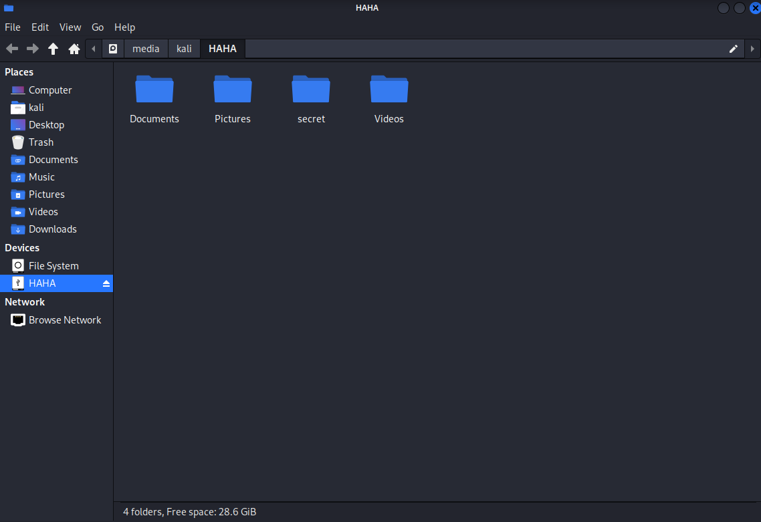
Demo: Magic Rescue – Initial Analysis
Notes:
Initially when opening the USB drive we can see there are 4 folders.

Slide 39
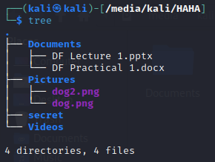
Demo: Magic Rescue – Folder Analysis
Suspicious empty folder “secret”
Have files been deleted (?)
Notes:
Using the tree command in the command line we can see that there is a suspicious folder named secret that is empty. This could be an indication that some files may have been deleted from the folder.
We will now use Magic Rescue to verify this hypothesis.

Slide 40
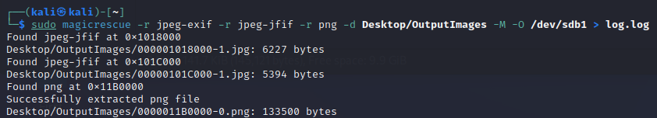
Demo: Magic Rescue – Recovering deleted files
Magic Rescue was configured to search for the following “recipes”:
jpeg-exif, jpeg-jfif & png (any image documents)
Msoffice (.doc, .docx, .pptx, or any Microsoft office documents)
Notes:
I used Magic Rescue to search for image documents or Microsoft Office documents since I was looking for evidence of a bank transfer.

Slide 41
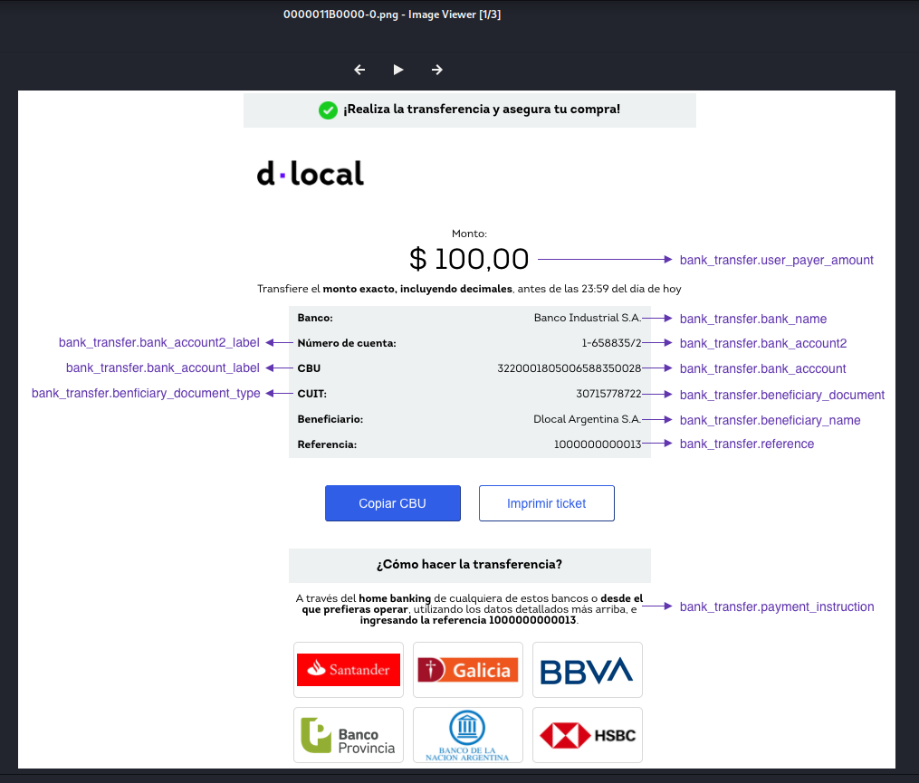
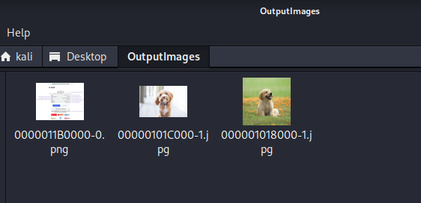
Demo: Magic Rescue – Recovered images
Notes:
The results of file carving for image files yielded positive results. A suspicious image file containing what looks like a bank transfer statement was recovered. The existing files on the drive were also Outputed into our output folder.

Slide 42
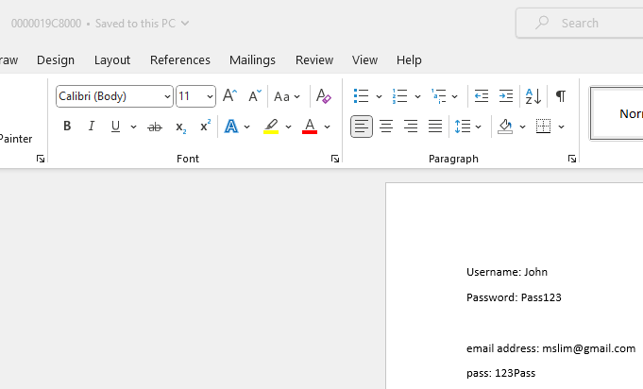
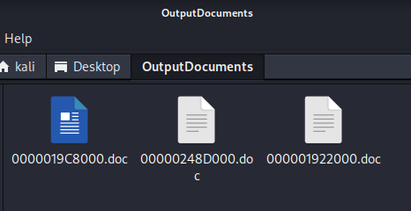

Demo: Magic Rescue – Recovered Office files
Notes:
Searching for Microsoft office documents also recovered a suspicious word document that contained usernames and passwords. This may or may not be the details suspect but it also could be details of the victim.

Slide 43
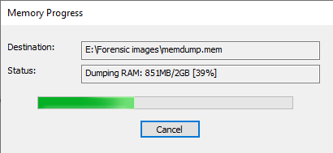

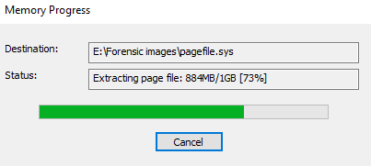
Demo: FTK Imager – Memory Dumping
Notes:
We should also dump the memory of the laptop immediately upon seizure so as to not lose any valuable data.
This can be done using FTK imager to obtain the memory dump and system files.

Slide 44
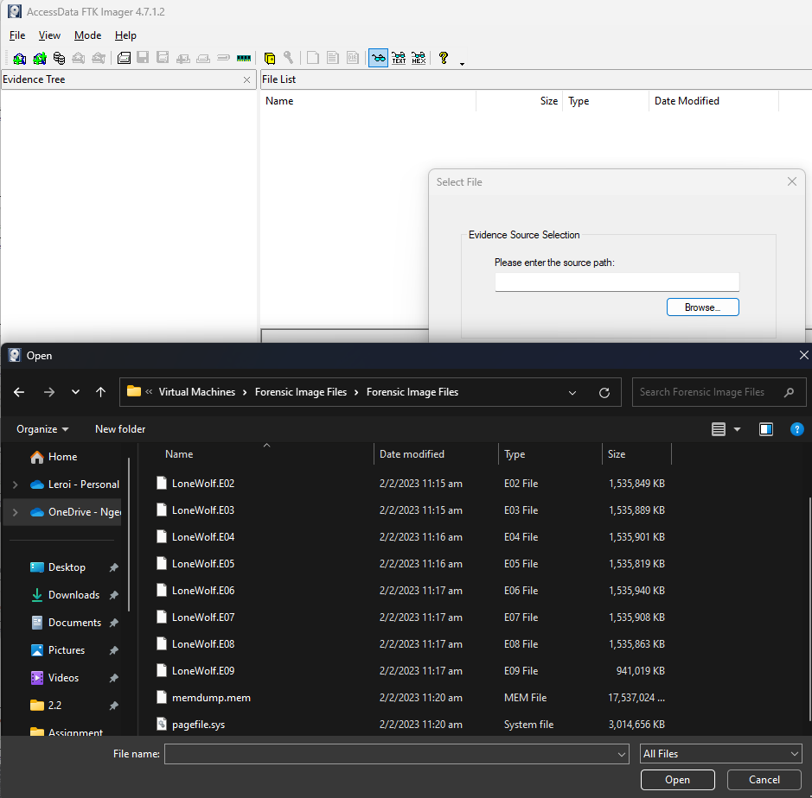
Demo: FTK Imager – After Imaging
Notes:
After imaging the laptop we have many forensic image files that we can analyse

Slide 45
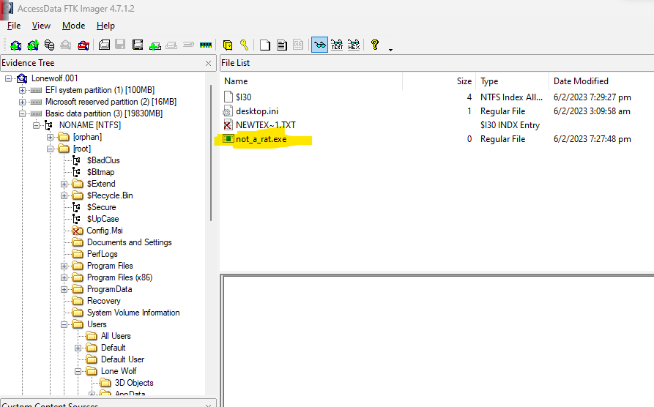
Demo: FTK Imager - Viewing evidence
Notes:
We can perform this analysis using FTK Imager to view the evidence at a surface level

Slide 46
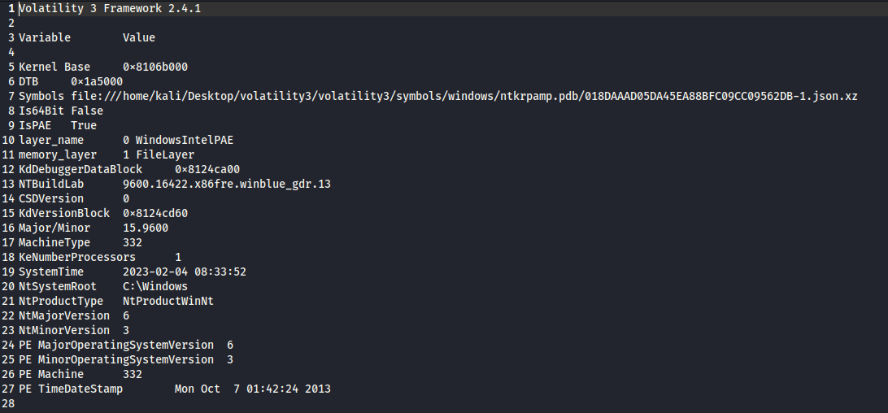
Demo: Volatility – windows.info Findings

Slide 47
Demo: Volatility – pslist Findings
One very interesting ImageFileName was found: not_a_rate.exee
Unusual cmd.exe activities
iexplore.exe ran before not_a_rat.exee

Slide 48
Demo: Volatility – windows.handles Findings
Access to a Registry Key that manages OS Configuration Data and Settings
Created A Mutant, indication of malware
Access to Registry Key that manages sorting algorithms
Can Modify Algorithm to Hide its Processes, Defense Mechanism
Access to some sort of API
Access to Advanced Local Procedure Call (ALPC) Port

Slide 49
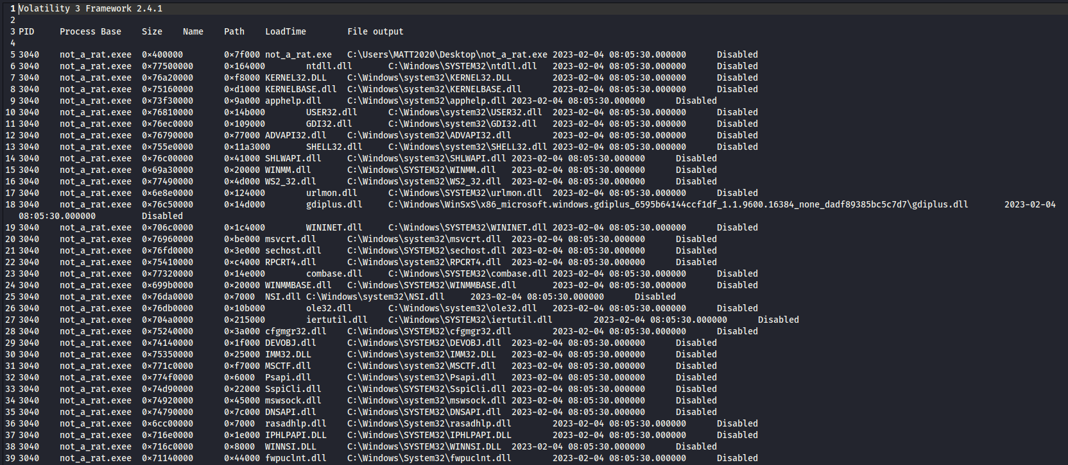
Demo: Volatility – windows.dlllist Findings

Slide 50
Demo: Volatility – windows.netscan Findings
Found one connection made by not_a_rat.exee
Foreign IP Would Normally Lead to IP of Host

Slide 51
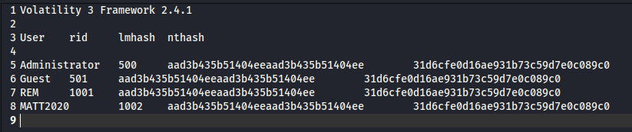
Demo: Volatility – windows.hashdump Findings

Slide 52
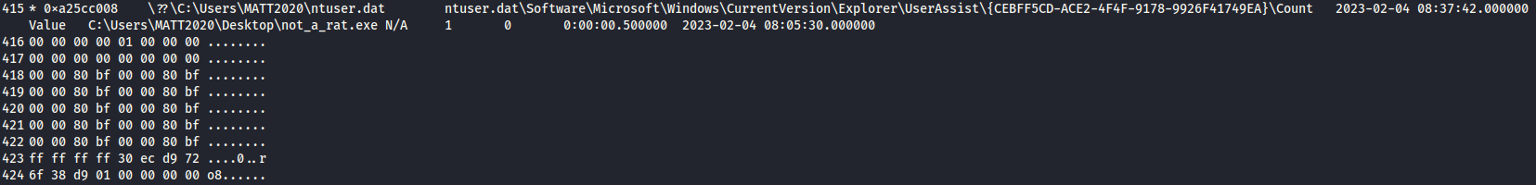
Demo: Volatility – windows.registry.userassist Findings
not_a_rat Ran on the Host PC as Indicated by the Output of the Command

Slide 53
Investigation Conclusion
Evidence of bank transfer and password list found in the USB Drive
Suspicious .exe file found on suspect’s laptop
Likely due to someone else running the Remote Access Trojan on the PC
Most Likely Not due to The Individual's on Action that the Bank Transfer was by him

Slide 54
Conclusion - Leroi
Magic Rescue:
Easy to use however generates a lot of noisy data
Better understanding of file carving
Gained exposure to variety of file types
File carving is time consuming
FTK Imager:
Better understanding of imaging technology
Importance of evaluating evidence before sending for further analysis
Imaging process is very long
Notes:
Some conclusions that I have firstly for magic rescue, Magic rescue is very easy to use, and its purpose is very straightforward, with only 1 command to use.
However some negatives about magic rescue is that it carves all instances of the file type it locates, which includes all the file types that are already existing on the drive. This results in a lot of noisy data being generated. Thus magic rescue should be used with other tools to be able to organise and filter the data that it acquires.
For FTK Imager is very useful for generating an image of the hard drive, however it does not provide any tools for image analysis. Thus only manual analysis can be performed and surface level analysis can only be done. It should be used for imaging for the image to be acquired and analysed by other tools, such as volatility

Slide 55
Conclusion – Eugene
Used Volatility on Memory File Acquired
Managed to Find useful Information that Could Be Relevant to the Case
Provides information that disk forensics does not like network connections and running processes
Is generally faster than disk forensics
Unable to recover deleted data or decrypt encrypted data

Slide 56
THANK YOU!

